Slide 1



CASE PRESENTATION
Syed Suleiman
2nd year mbbs
Osmec-516
Email:suleimansyed16@gmail.com
This Photo by Unknown Author is licensed under CC BY-SA

Slide 2

CASE DETAILS:
Patient details:
Name: xxxxxx
Age: 4 years
Sex: female
Informant: mother
Father’s name: xxxxxx
Address: Saidabad, Hyderabad.
Presenting complaints:
Brought by her mother with chief complaint of-
High fever since the past 4 days.
Stomach pain and vomiting 2 days ago.
Rash and redness of eyes since the past 3 days.
Facial puffiness since the past 3 days.
Work of breathing since the past 2 days.

Slide 3
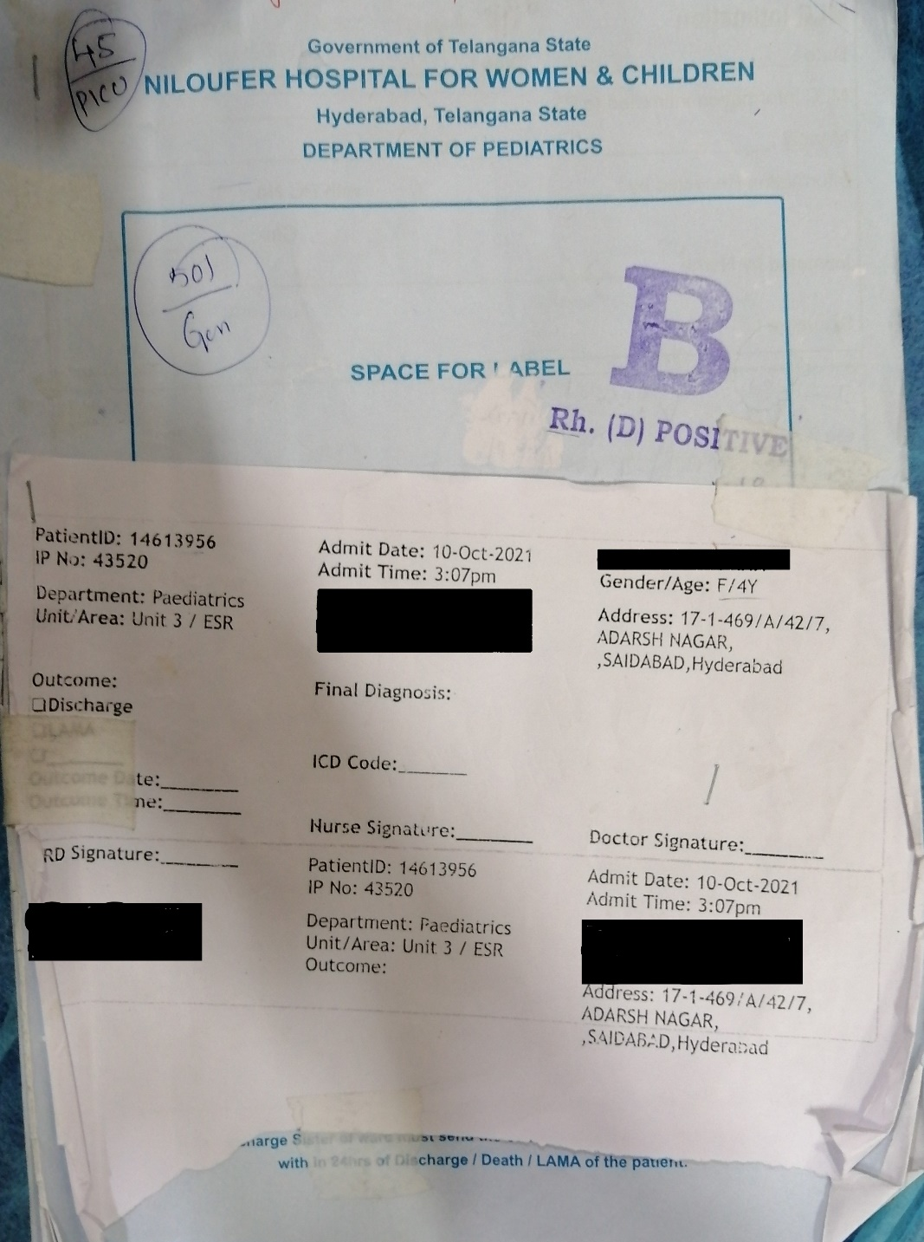
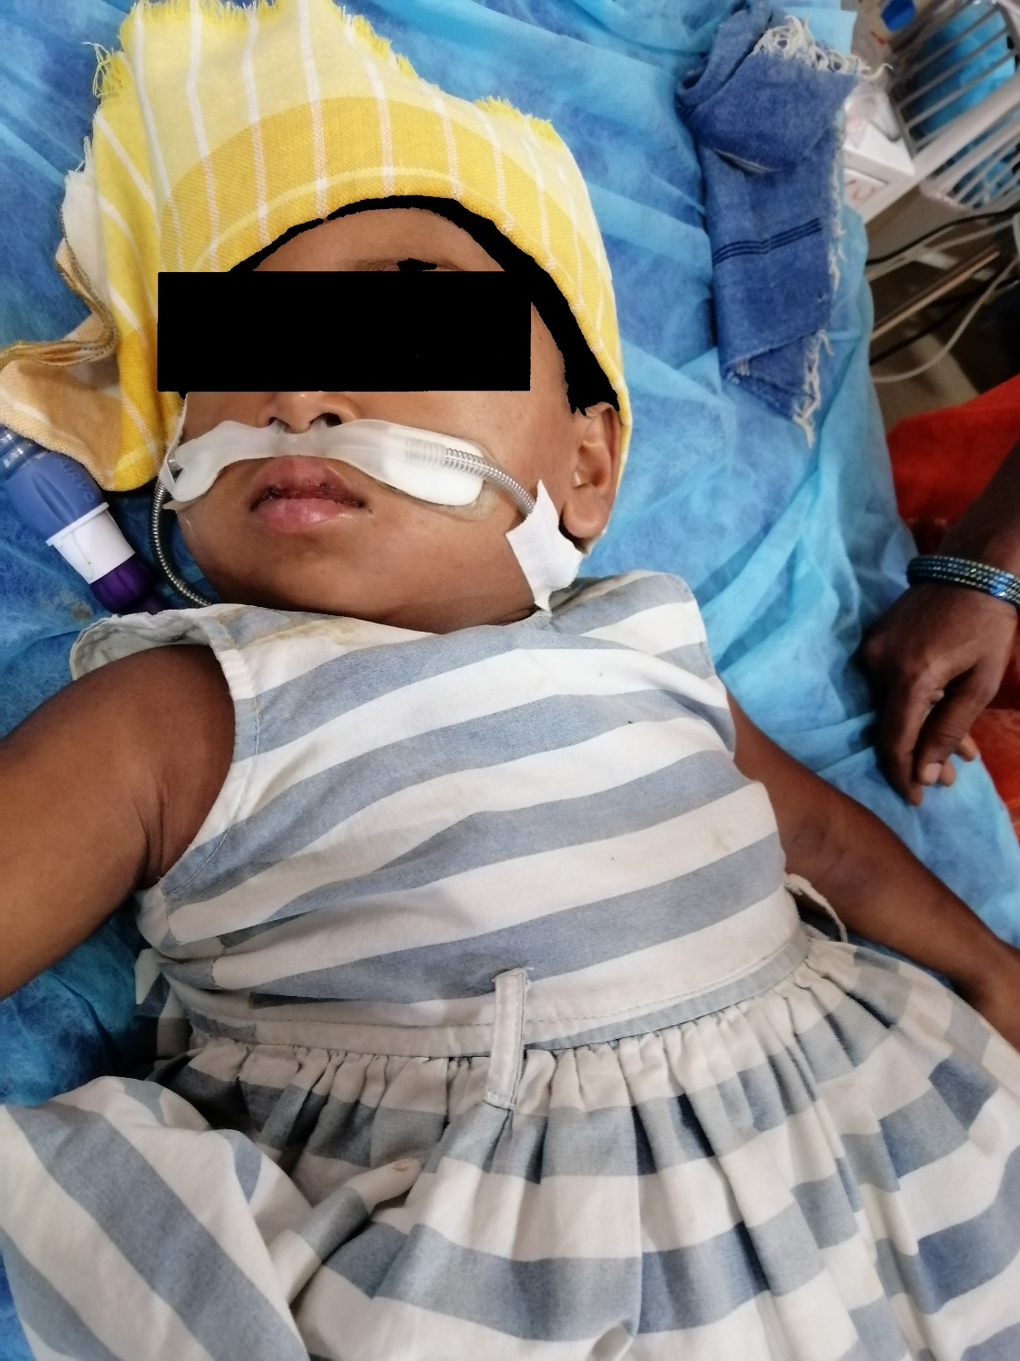

Slide 4

History of presenting illness:
Child was apparently asymptomatic 4 days ago.
She then developed high-grade fever (4 days ago) which was
Sudden-onset
Continuous
Not associated with chills and rigor
Not relieved by medicines
Red erythematous generalized rash and non-purulent conjunctivitis since the past 3 days
Dull aching gradual pain abdomen since 2 days.

Slide 5
History of presenting illness:
Vomiting for 1 day( 2 days back)
4 episodes
Associated with feeding and contents were feeds
Generalized edema since 3 days.
Work of breathing for 2 days.
No history of headache and body pains.
No history of epistaxis, bleeding gums, melena and hematuria.
No history of peeling of skin.
No history of diarrhea.

Slide 6
Past history:
History of COVID-19 infection in both parents and child 4 weeks ago.
No similar complaints in the past.
No history of cough, sore throat, throat pain and cold.
No history of contact with TB patients.
No history of any chronic illness.

Slide 7
History:
Family history:
Development history: No significant
abnormalities noted
6 years
4 years
Birth history: All trimesters of mother were uneventful.
Dietary history: Normal mixed diet.
Immunization history: Up to date.
Socio-economic class: Lower class.

Slide 8
General examination:
On examination patient was in altered sensorium.
Generalized edema present.
No evidence of pallor, icterus, cyanosis, clubbing of nails, koilonychias and lymphadenopathy.
Vitals: Temperature: 103 °F
Blood pressure: Low BP- 70/50 mmHg.
Pulse: rate: Tachycardia 168 beats/min( normal:95-110) and low
volume pulse.
Respiratory rate: 59/min( normal:20-30)
SpO2: 95% on room air.
Height:96 cm Weight:15 kg

Slide 9
Systemic examination:
CVS: S1, S2 normal.
Respiratory: Bilateral airway entry positive. Breathlessness at rest with tachypnoea( 59/min.)
CNS: No abnormality detected.

Slide 10
CASE SUMMARY
A 4 year old female child, born of 3rd degree consanguineous marriage was brought with complaints of fever, abdominal pain, vomiting, rash, conjunctivitis and facial puffiness.
History revealed previous exposure and infection of COVID-19 four weeks ago.
On examination signs of shock were noted along with tachypnoea and tachycardia. Generalized swelling and red erythematous rash were also noted.
PROVISIONAL DIAGNOSIS: Suspected Multisystem Inflammatory Syndrome in Children (MIS-C) [a.k.a Kawa-COVID-19]

Slide 11

Differential diagnosis What other disease can it be…
MIS-C
Kawasaki disease
Bacterial sepsis
Dengue
Toxic shock syndrome

Slide 12
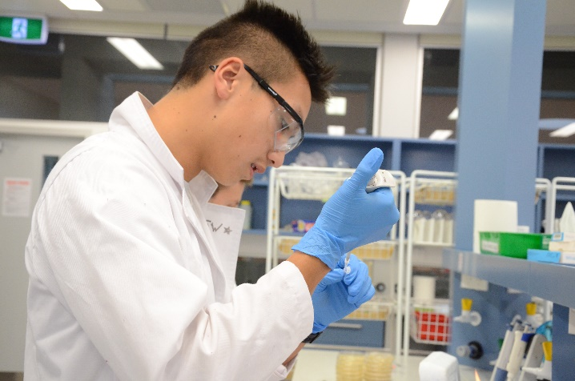
Investigations:
1.CBP: Platelets: 1,00,000 cells/ cu mm
Absolute neutrophil count( ANC): 9000/uL ( 88%)
Absolute lymphocyte count( ALC): 800/uL ( 7%)
Hemoglobin: 11 gms%
RBC count: 4 million cells/ uL
WBC count:11,000 cells/uL
Monocytes: 4 %
Eosinophils: 1%
Impression: Thrombocytopenia along with high ANC and low ALC suggestive of inflammation.
2. COVID-IgG positive. RTPCR: negative.
3. LFT: Serum albumin=2.9 g/dL( normal 3.5-5 g/dL)
AST: 60 U/L
ALT: 75 U/L
4. RFT: Creatinine elevated: 1.2 mg/dL.
BUN: 19 mg/dL.

Slide 13

Investigations:
5.Markers: 1.CRP: highly elevated 200 mg/dL(normal:1-5 mg/dL.)
2.ESR: elevated 56 mm/hr( normal: 5-15 mm/hr.)
3.D-dimer: elevated 500 ng/ml( normal:<250 ng/ml.)
4.Ferritin: elevated 2000 ng/ml( normal:10-150 ng/mL.)
Markers of inflammation are elevated confirming inflammation.
6. Ns1: negative( ruling out dengue.)
7. Blood culture: showed no bacterial growth after 24 hours incubation.

Slide 14
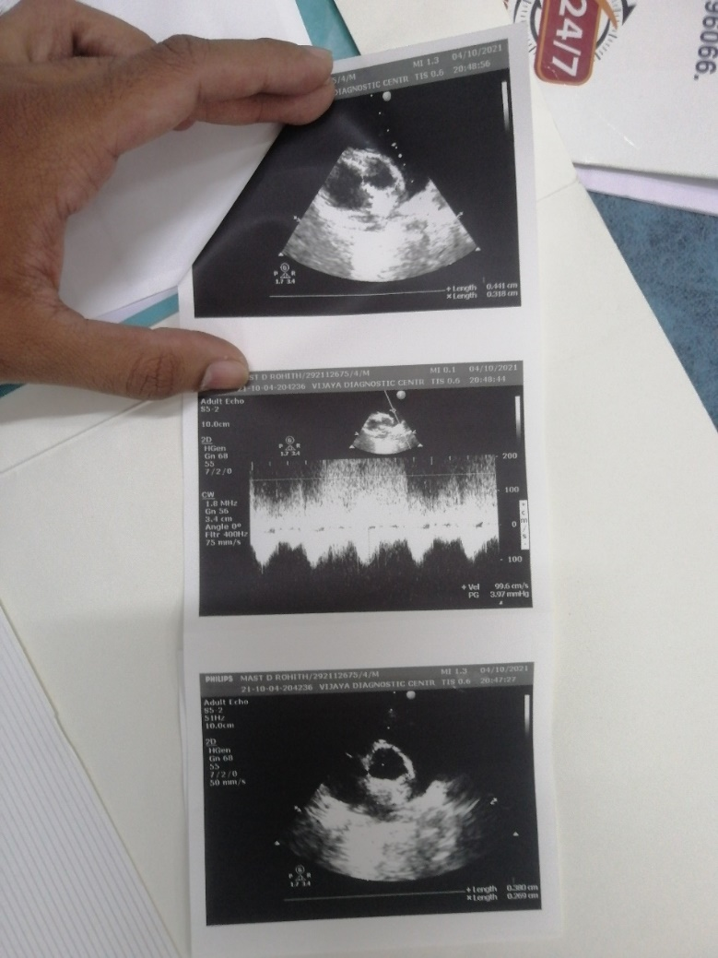
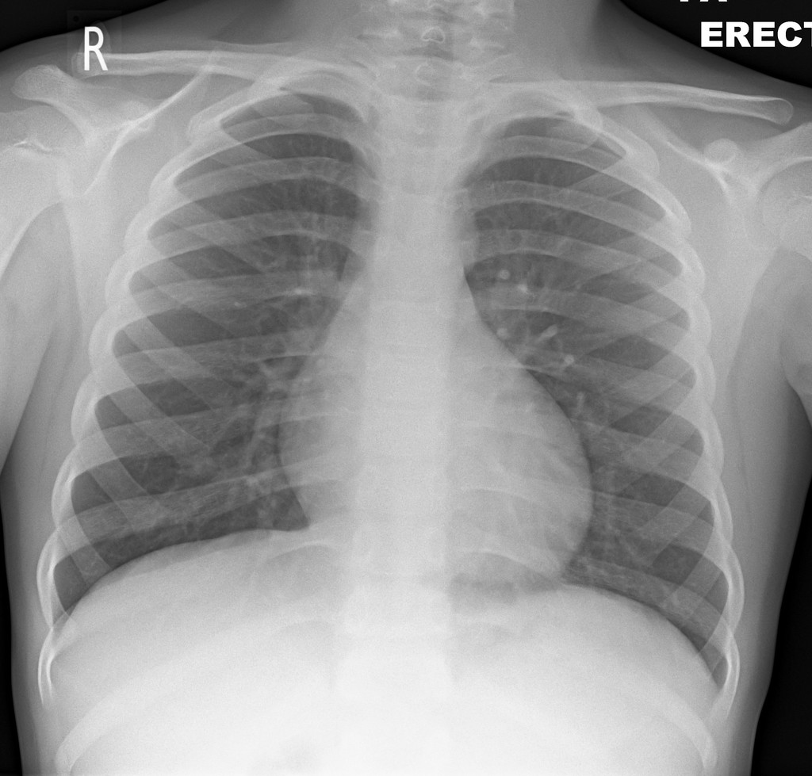
Investigations:
8. Chest X-ray appears to be normal
9. 2D echo: dilated coronaries

Slide 15

FINAL DIAGNOSIS
Multisystem Inflammatory Syndrome in Children (MIS-C) also called as Kawa-COVID-19.

Slide 16

MANAGEMENT:
IVIG: 1 g/kg/day over 2 days.
IV Methylprednisolone: 10-30 mg/kg/day.
Aspirin: 3-5 mg/kg/day.
Use empiric antibiotics until blood culture sensitivity report arrives.

Slide 17
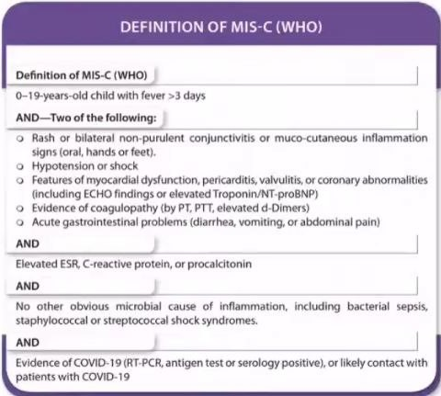
What is MISC? How is it different from Kawasaki disease?
Multisystem inflammatory syndrome (MIS) can affect children (MIS-C) and adults (MIS-A). MIS is a rare but serious condition associated with COVID-19 in which different body parts become inflamed, including the heart, lungs, kidneys, brain, skin, eyes, or gastrointestinal organs.
Pathophysiology: The exact etiology is not known but it is believed to be a result of an abnormal immune response to COVID-19 virus. The syndrome often mimics kawasaki disease but the immunophenotype is distinct and different.
 | MIS-C | Kawasaki
GIT involvement | More common and intense | Less incidence and severity
CVS | Myocardial involvement, coronary artery dilations. | Giant artery aneurysms, coronary artery dilations.
Platelets | Thrombocytopenia | Thrombocytosis
Inflammatory markers | ↑↑↑ | ↑

Slide 18

Under the guidance of:
THANK YOU!!
Department of pediatrics ( Niloufer hospital):
Dr C.Nirmala ( Professor)
Dr Krishna Chaitanya ( Post graduate)
Dr Anas ( Post graduate)

